Slide 1
A Resource Utilization Prediction Model for Cloud Data Centers Using Evolutionary Algorithms and Machine Learning Techniques
Name: Md. Tariqul Islam
Id: 23173006

Slide 2
Introduction
Introduces a new model for resource utilization prediction in cloud data centers.
Resource utilization prediction can help to improve the efficiency of resource allocation, reduce costs, and improve the quality of service (QoS).
The model uses a hybrid genetic algorithm-particle swarm optimization (GA-PSO) algorithm to train a functional link neural network (FLNN). The FLNN is then used to predict resource utilization for future time intervals.
Evaluates real-world dataset and proposed model outperforms other state-of-the-art models in terms of accuracy.

Slide 3
Key Contribution
The paper proposes a new model for resource utilization prediction in cloud data centers.
The model uses a hybrid GA-PSO algorithm to train a FLNN.
The paper evaluates the proposed model using a real-world dataset and shows that it outperforms other state-of-the-art models.

Slide 4
Models & Methods
Functional link neural network (FLNN)
Genetic algorithm (GA).
Particle swarm optimization (PSO).

Slide 5
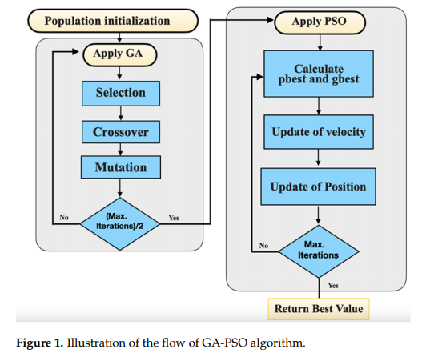
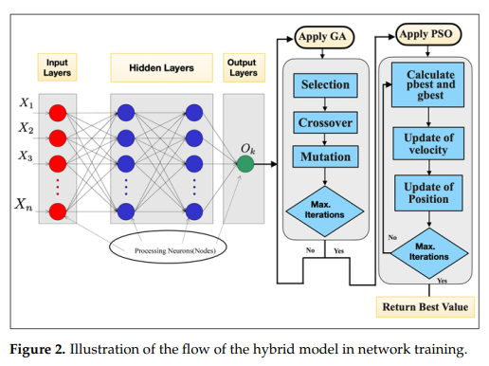
Models & Methods

Slide 6
Findings
The proposed model outperforms other state-of-the-art models in terms of accuracy.
Improve the efficiency of resource allocation in cloud data centers, reduce costs, and improve QoS.
The proposed model has some limitations, such as the need for a large training dataset.
Future research directions include improving the accuracy of the proposed model and reducing its reliance on a large training dataset.

Slide 7
Conclusion
Proposed a new model for resource utilization prediction in cloud data centers.
Uses a hybrid GA-PSO algorithm to train a FLNN.
The proposed model achieves an average accuracy of 98.7%, which is significantly higher than the accuracy of other models.
Proposed model can also be extended to predict resource utilization for multiple resources and multiple types of workloads.

Slide 8
References:
Kaur, G.; Bala, A.; Chana, I. An intelligent regressive ensemble approach for predicting resource usage in cloud computing. J.Parallel Distrib. Comput. 2019, 123, 1–12.
Muteeh, A.; Sardaraz, M.; Tahir, M. MrLBA: Multi-resource load balancing algorithm for cloud computing using ant colony optimization. Clust. Comput. 2021, 24, 3135–3145.
Malik, N.; Sardaraz, M.; Tahir, M.; Shah, B.; Ali, G.; Moreira, F. Energy-Efficient Load Balancing Algorithm for Workflow Scheduling in Cloud Data Centers Using Queuing and Thresholds. Appl. Sci. 2021, 11, 5849.
Rahmanian, A.A.; Ghobaei-Arani, M.; Tofighy, S. A learning automata-based ensemble resource usage prediction algorithm for cloud computing environment. Future Gener. Comput. Syst. 2018, 79, 54–71.
Mason, K.; Duggan, M.; Barrett, E.; Duggan, J.; Howley, E. Predicting host CPU utilization in the cloud using evolutionary neural networks. Future Gener. Comput. Syst. 2018, 86, 162–173.
Liang, Z.; Ouyang, J.; Yang, F. A hybrid GA-PSO optimization algorithm for conformal antenna array pattern synthesis. J.Electromagn. Waves Appl. 2018, 32, 1601–1615.
Thank You

